Slide 1
PRESENTATION ON
TREE
IN
DATA STRUCTURE

Slide 2
Tree In Data Structure
In computer science, the term "tree" typically refers to a data structure known as a tree data structure. A tree is a hierarchical structure composed of nodes connected by edges. Each node in a tree has a parent node (except for the root node) and zero or more child nodes.

Slide 3

NATURE VEIW OF A TREE
Leaves
Branches
Root

Slide 4
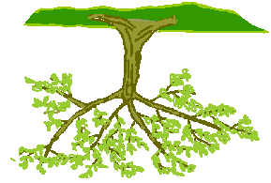
Computer Scientist’s View
Root
Branches
Leaves
Node

Slide 5
What Is Tree
Tree contains:
Parent Node
Child Node
Root Node
Leaf Node or External Node
Sibling
Level of a node
Internal node
Subtree
Depth of tree
Height of tree
Edge
A hierarchical structure used to represent and organize data in a way that is easy to navigate and search.
It is a collection of nodes that are connected by edges having hierarchical relationship between them.

Slide 6
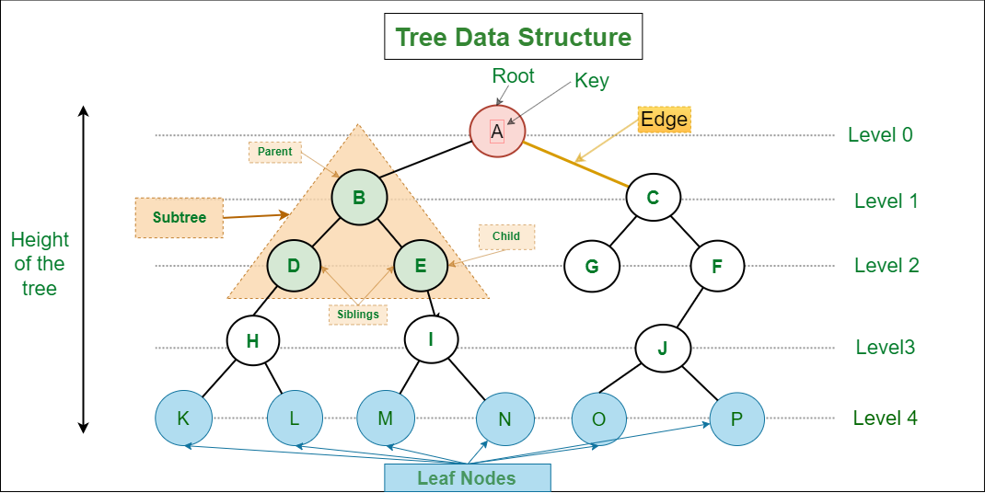

Slide 7
Applications of Tree
Sorting naturally hierarchical data- File System
Organize data for quick search, insertion, and deletion- Binary Search Tree
Network routing Algorithm
Artificial Intelligence

Slide 8
Binary Tree
Each node can have at most 2 children
A node has only left and right child or
Only left child or
Only right child
A leaf node has no left or right child
A leaf node has only NULL

Slide 9
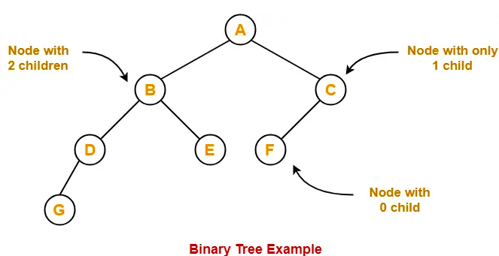
Example

Slide 10
Types of Binary Tree
Full/Strictly binary tree
Complete/perfect binary tree
Skewed binary tree
Almost complete binary tree

Slide 11
Full/Strictly binary tree
every node has either 0 or 2 children.
also known as Strictly binary tree.

Slide 12
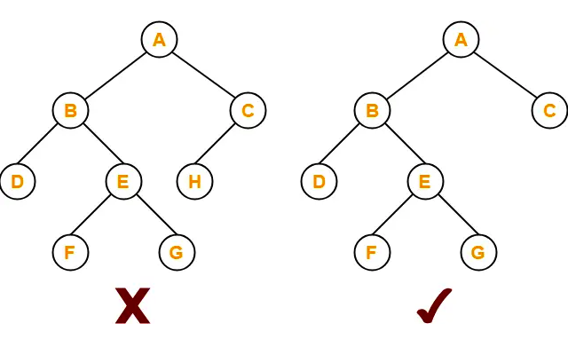
Example

Slide 13
Complete/perfect binary tree
complete binary tree has 2 properties:
Every internal node has exactly 2 children.
All the leaf nodes are at the same level.

Slide 14
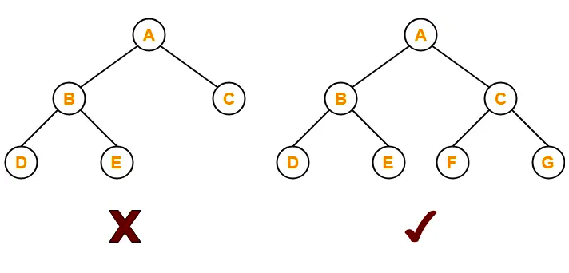
Example

Slide 15
Skewed binary tree
skewed binary tree has 2 properties
All the nodes except one node have one and only one child.
The remaining node has no child.
OR
a binary tree of n nodes such that its depth is (n-1).

Slide 16
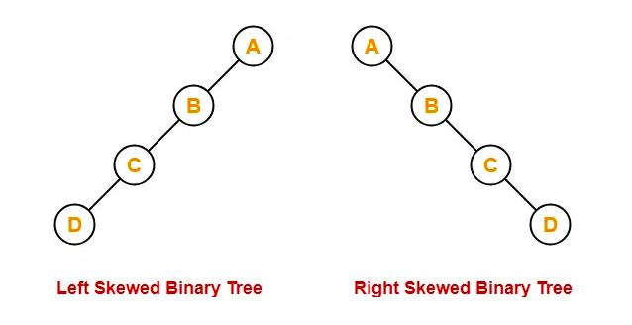
Example

Slide 17
Almost complete binary tree
Every level of the tree is filled except the last level.
All levels, except possibly the last one, are completely filled with nodes.

Slide 18
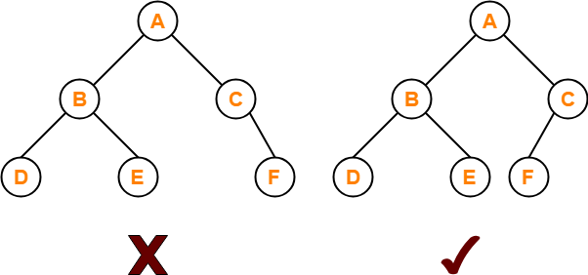
Example

Slide 19
Applications of Binary Tree
Data Searching
Data Sorting
Network Routing Algorithm
Games Tree in Artificial Intelligence

